Slide 1
CSCI 3412 Algorithm
Module 3: Introduction to Python, Part 2
Sung Nam

Slide 2
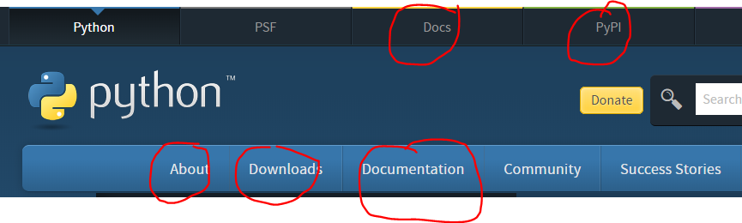
Installation & Documentation
Google “Python xxx”
Some popular sites:
https://www.python.org/
Youtube tutorials:
Python in 45 minutes for programmers: https://www.youtube.com/watch?v=N4mEzFDjqtA
https://www.youtube.com/watch?v=rfscVS0vtbw (4.5 hours)
Python for everyone: https://www.youtube.com/watch?v=8DvywoWv6fI
Google “python anaconda” to install Python3 and Jupyter notebook
Google “python free IDE (editor)”
Google “python PEP(Python Enhancement Proposal) 8 -- Style Guide for Python Code”

Slide 3
Functions
Syntax, Definition, invocation, return, parameters, scope

Slide 4
GOOD PROGRAMMING
More code is not necessarily a good thing
Measure good programs by the amount of functionality
Introduce functions
Mechanism to achieve decomposition and abstraction

Slide 5
Python FUNCTIONS
Functions are not run in a program until they are “called” or “invoked” in a program
Function characteristics:
has a name
has parameters (0 or more)
has a docstring (optional but recommended for documentation)
has a body
returns something

Slide 6
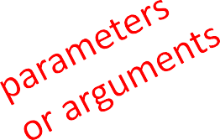
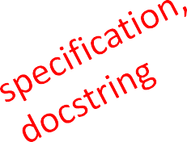
WRITE and CALL/INVOKE A FUNCTION
def
is_even(
i ):
"""
Input: i, a positive int
Returns True if i is even, otherwise False
"""
print("inside is_even")
return i%2 == 0
is_even(3)
Note:
No parameter type is specified
No return type is specified
Doc string

Slide 7
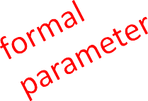
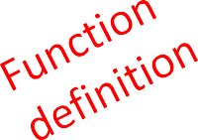
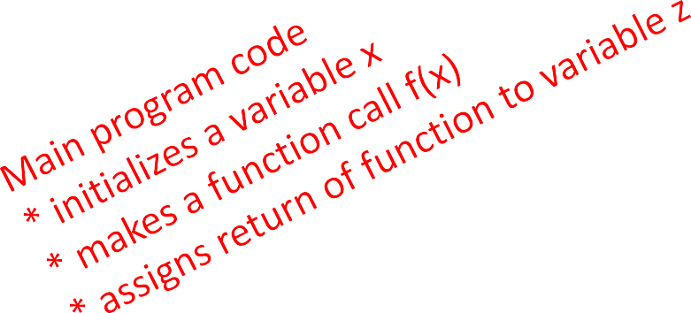
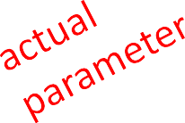
Function Example
Formal parameter gets bound to the value of actual argument when function is called
New scope/frame/environment created when enter a function
Scope is mapping of names to objects
def f( x ):
x = x + 1
print('in f(x): x =', x)
return x
x= | 3
z = | f( | x | )

Slide 8
VARIABLE SCOPE
def f( x ):
x = x + 1
print('in f(x): x =', x)
return x
f scope
x
returns 4
Global scope
f
Some
code
4
x
3
x = 3
z = f( x )
Print ('z:', z) # 3 or 4?
z

Slide 9

No return STATEMENT
def is_even( i ):
"""
Input: i, a positive int Does not return anything """
i%2 == 0
Python returns the value None (void in C++), if no return statement is given
Represents the absence of a value

Slide 10
FUNCTIONS AS ARGUMENTS
Arguments can take on any type, even functions
def func_a():
print ('inside func_a')
def func_b(y):
print ('inside func_b')
return y
def func_c(z):
print ('inside func_c')
return z()
print (func_a(), "\n")
print (5 + func_b(2))
print ("hello " + func_b("world") + "!\n")
print (func_c(func_a))
print (func_c (5)) # RuntimeError
inside func_a
None
inside func_b
7
inside func_b
hello world!
inside func_c
inside func_a
None
inside func_c
Traceback :
File "main.py", line 24, in <module>
print (func_c (5))
File "main.py", line 16, in func_c
return z()
TypeError: 'int' object is not callable

Slide 11
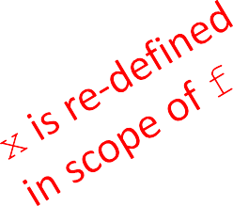
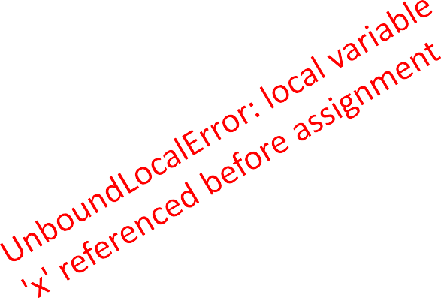
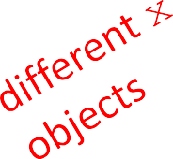
SCOPE EXAMPLE
https://www.python-course.eu/passing_arguments.php
Inside a function, can access a variable defined outside
Inside a function, cannot modify a variable defined outside -- can use global variables, but strongly discouraged for readability
def f(y): def g(y): def h(y):
x = 1
x += 1
print(x) x += 1 print(x + 1)
x = 5
print(x)
x = 5 g(x) print(x)
h(x) print(x)
x = 5
f(x) print(x)
x inside g(y) is picked up from the scope that called function g
11

Slide 12
Data Structures
Tuple, list, operations, sorting lists, dictionary

Slide 13
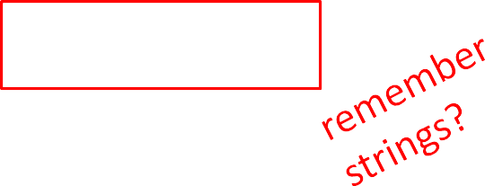
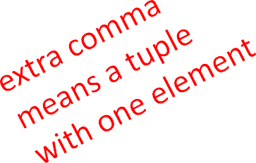
TUPLES
an ordered sequence of elements, can mix element types
cannot change element values, immutable
represented with parentheses, ()
t = () // empty t
t = (2,"ucd",3) t[0]
(2,"ucd",3) + (5,6)
→ evaluates to 2
→ evaluates to (2,"ucd",3,5,6)
t[1:2]
t[1:3]
len(t)
→ slice tuple, evaluates to ("ucd",)
>>>print (type((1))) #int
>>>print (type((1,))) #tuple
→ slice tuple, evaluates to ("ucd",3)
→ evaluates to 3
t[1] = 4 → gives error, can’t modify object

Slide 14

TUPLES
Conveniently used to swap variable values
x = y
y = x
temp = x x = y
y = temp
x, y = y, x
(x, y) = (y, x)
Used to return more than one value from a function
def quotient_and_remainder(x, y):
q = x // y # //, NOT /
r = x % y
return (q, r) # or return q, r
(quot, rem) = quotient_and_remainder(4,5)

Slide 15
LISTS (similar to C++ vector)
Ordered sequence of information, accessible by index
A list is denoted by square brackets, []
A list contains elements
usually homogeneous (ie, all integers)
technically, can contain mixed types (uncommon)
Distinguishable from C++ vector
List elements can be changed so a list is mutable

Slide 16

INDICES AND ORDERING
a_list = []
L = [2, 'a', 4, [1,2]]
len(L)
L[0]
L[2]+1
L[3]
L[4]
i = 2 L[i-1]
→ evaluates to 4
→ evaluates to 2
→ evaluates to 5
→ evaluates to [1,2], another list!
→ gives an error
→ evaluates to ‘a’ since L[1]='a' above

Slide 17

CHANGING ELEMENTS
Lists are mutable!
Assigning to an element at an index changes the value
L = [2, 1, 3]
L[1] = 5
L is now [2, 5, 3], note this is the same object, L
[2,5,3]
L

Slide 18
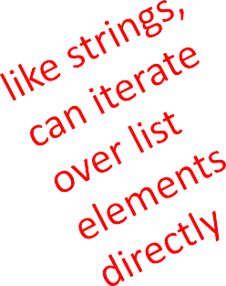
ITERATING OVER A LIST
Compute the sum of elements of a list
common pattern, iterate over list elements
total = 0
for i in range(len(L)): total += L[i]
print (total)
Notice:
list elements are indexed 0
total = 0
for aNum in L:
total += aNum print (total)
to len(L)-1
range(n) goes from 0 to n-1

Slide 19
OPERATIONS ON LISTS - ADD
Add elements to the end of list with L.append(element)
Mutates the list!
L = [2,1,3]
L.append(5) → L is now [2,1,3,5]
what is the dot?
Lists are Python objects, everything in Python is an object including primitive types
Objects have data
Objects have methods (functions)
Access this information by object_name.do_something()
x, y = (4, 5)
print (x + y)
print (x.__add__(y))

Slide 20
OPERATIONS ON LISTS - ADD
To combine lists together, use concatenation ( + operator) which returns a new list
Mutate a list with L.extend(some_list)
L1 | = | [2,1,3]
L2 | = | [4,5,6]
L3 | = | L1 + L2 |  | → L3 is [2,1,3,4,5,6] (L1, L2 unchanged )
L1.extend([0,6])
→ mutated L1 to [2,1,3,0,6]

Slide 21
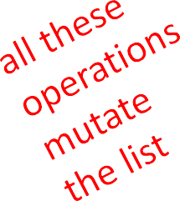
OPERATIONS ON LISTS - REMOVE
Delete an element at a specific index with del(L[index])
Remove element at the end of list with L.pop(), returns the removed element
Remove a specific element with L.remove(element)
looks for the element and removes it
if element occurs multiple times, removes first occurrence
if element not in list, gives an error
L = [2,1,3,6,3,7,0] # do below in order
L.remove(2) → mutates L = [1,3,6,3,7,0]
L.remove(3) → mutates L = [1,6,3,7,0]
del(L[1])
L.pop() L.pop(1)
→ mutates L = [1,3,7,0]
→ returns 0 and mutates L = [1,3,7]#stack pop
→returns 3 and mutates L = [1,7]

Slide 22
CONVERT LISTS TO STRINGS AND BACK
convert string to list with list(s), returns a list with every character from s an element in L
can use s.split(), to split a string on a character parameter, splits on any whitespace if called without a parameter
use ''.join(L) to turn a list of characters into a string, can give a character in quotes to add char between every element
s = "I<3 cs" list(s) s.split('<')
L = ['a','b','c']
''.join(L)
'_'.join(L)
→ s is a string
→ returns ['I','<','3',' ','c','s']
→ returns ['I', '3 cs']
→ L is a list
→ returns "abc"
→ returns "a_b_c"

Slide 23
OTHER LIST OPERATIONS
sort() and sorted()
reverse()
and many more! https://docs.python.org/3/tutorial/datastructures.html
L=[9,6,0,3]
sorted(L) L.sort() L.reverse()
→ returns sorted list, does not mutate L
→ mutates L=[0,3,6,9],in-place sorting
→ mutates L=[9,6,3,0]

Slide 24
LISTS IN MEMORY
Lists are mutable
Behave differently than immutable types
An object in memory
Variable name points to object
Any variable pointing to that object is affected
Key point to remember working with List: Side effects

Slide 25
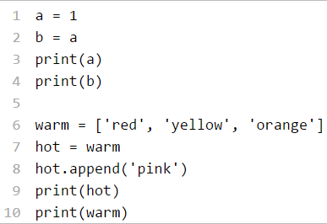
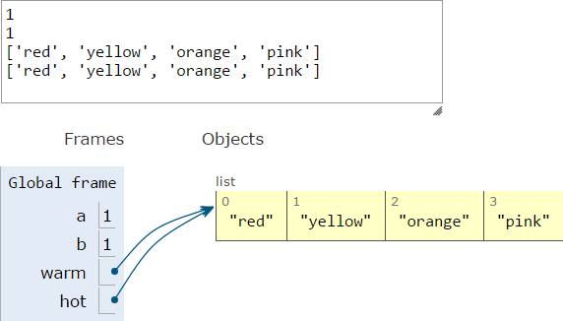
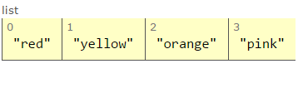
ALIASES (Shallow copy)
hot is an alias for warm – changing one changes the other!
append() has a side effect

Slide 26
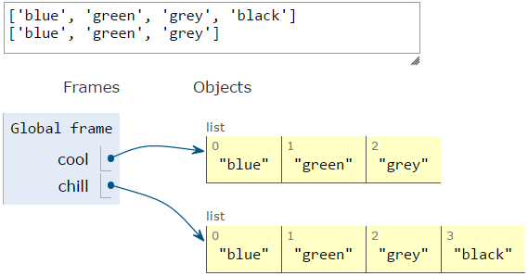
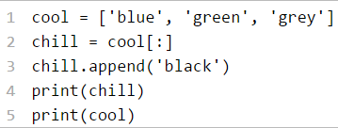
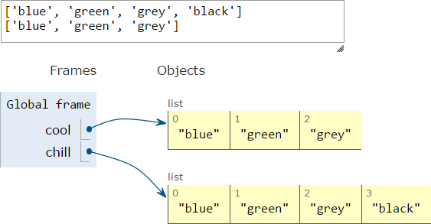
CLONING A LIST (Deep copy)
Create a new list and copy every element using
chill = cool[:]

Slide 27
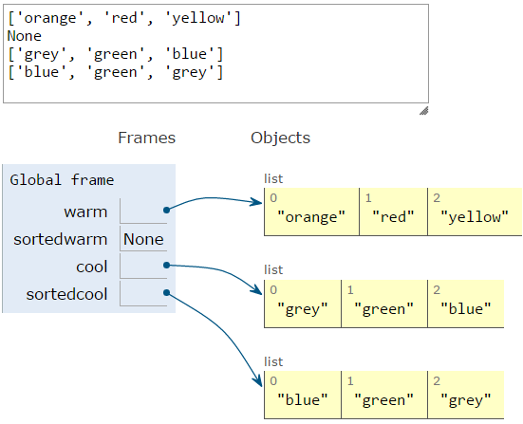
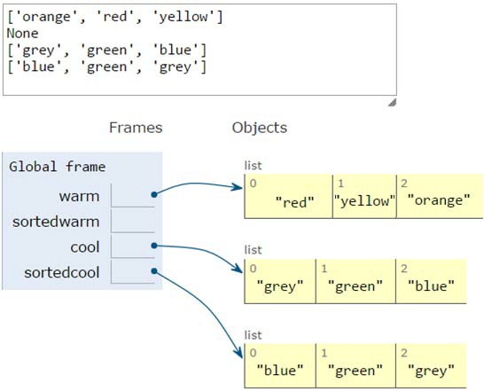
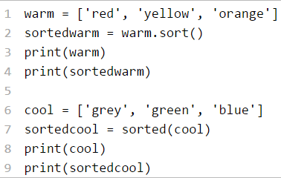
SORTING LISTS
calling sort()mutates the list, returns nothing
calling sorted() does not mutate list, must assign result to a variable

Slide 28
L.sort() vs sorted(L)
sorted() returns a new sorted list, leaving the original list unaffected. list.sort() sorts the list in-place, mutating the list indices, and returns None (like all in-place operations).
sorted() works on any iterable object, not just lists. Strings, tuples, dictionaries (you'll get the keys), generators, etc., returning a list containing all elements, sorted.
Use list.sort() when you want to mutate the list, sorted() when you want a new sorted object back. Use sorted() when you want to sort something that is an iterable, not a list yet
For lists, list.sort() is faster than sorted() because it doesn't have to create a copy.
You cannot retrieve the original positions. Once you called list.sort() the original order is gone.

Slide 29
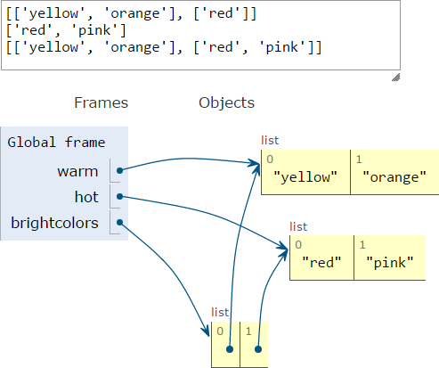
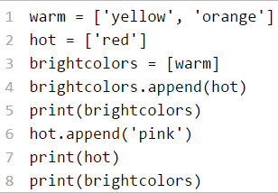
LISTS OF LISTS OF LISTS OF….
can have nested lists
side effects still possible after mutation

Slide 30
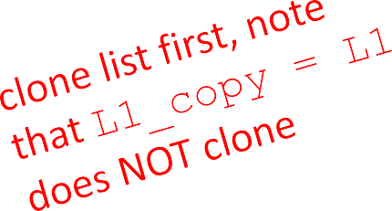
MUTATION AND ITERATION
Avoid mutating a list as you are iterating over it
def remove_dups(L1, L2): for e in L1:
if e in L2:
L1.remove(e)
def remove_dups(L1, L2):
L1_copy = L1[:]
for e in L1_copy: if e in L2:
L1.remove(e)
L1 = [1, 2, 3, 4]
L2 = [1, 2, 5, 6]
remove_dups(L1, L2)
L1 is [2,3,4] not [3,4] Why?
Python uses an internal counter to keep track of index it is in the loop
mutating changes the list length but Python doesn’t update the counter
loop never sees element 2

Slide 31
HOW TO STORE STUDENT INFO
So far, can store using separate lists for every info
names = ['Ana','John','Denise','Katy']
grade = ['B', 'A+’, 'A’, 'A']
course =[2.00, 6.0001, 20.002, 9.01]
A separate list for each item
Each list must have the same length
Info stored across lists at same index, each index refers to info for a diﬀerent person
31

Slide 32
UPDATE/RETRIEVE STUDENT INFO
def get_grade(student, name_list, grade_list, course_list):
i = name_list.index(student)
grade = grade_list[i]
course = course_list[i]
return (course, grade)
Messy to keep track of many different lists
(n many lists and pass them as arguments)
Must always index using integers
Must remember to change multiple lists
32

Slide 33

A BETTER WAY – A DICTIONARY
Nice to index the item of interest directly (not always int)
Nice to use one data structure, no separate lists
A list A dictionary
0 | Elem 1
1 | Elem 2
2 | Elem 3
3 | Elem 4
… | …
Key 1 | Val 1
Key 2 | Val 2
Key 3 | Val 3
Key 4 | Val 4
… | …

Slide 34
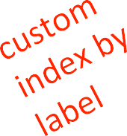

PYTHON DICTIONARY
Store pairs of data :
Key (name)
value
'Ana' | 'B'
'Denise' | 'A'
'John' | 'A+'
'Katy' | 'A'
Key 1
Val 1
Key 2
Val 2
Key 3
Val 3
…
…
my_dict = {}
grades = {'Ana':'B', 'John':'A+', 'Denise':'A', 'Katy':'A'}
key1 val1 key2 val2
key3 val3 key4 val4
34

Slide 35
DICTIONARY LOOKUP
Similar to indexing into a list
Looks up the key
Returns the value associated with the key
If key isn’t found, get an error
grades = {'Ana':'B', 'John':'A+', 'Denise':'A', 'Katy':'A'}
'Ana' | 'B'
'Denise' | 'A'
'John' | 'A+'
'Katy' | 'A'
grades['John'] grades['Sylvan']
→ evaluates to 'A+'
→ gives a KeyError

Slide 36
DICTIONARY OPERATIONS | 'Ana' | 'B'
 | 'Denise' | 'A'
 | 'John' | 'A+'
 | 'Katy' | 'A'
 | 'Sylvan' | 'A'
grades = {'Ana':'B', 'John':'A+', 'Denise':'A', 'Katy':'A'}
add an entry
grades['Sylvan'] = 'A'
test if key in dictionary
'John' in grades 'Daniel' in grades
delete entry
del(grades['Ana'])
→ returns True
→ returns False
36

Slide 37
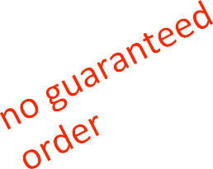

DICTIONARY OPERATIONS | 'Ana' | 'B'
 | 'Denise' | 'A'
 | 'John' | 'A+'
 | 'Katy' | 'A'
grades = {'Ana':'B', 'John':'A+', 'Denise':'A', 'Katy':'A'}
Get an iterable that acts like a tuple of all keys
grades.keys() # returns ['Denise','Katy','John','Ana']
Get an iterable that acts like a tuple of all values
grades.values() # returns ['A', 'A', 'A+', 'B']
37

Slide 38
DICTIONARY KEYS and VALUES
Values
Any type (immutable and mutable)
Can be duplicates
Dictionary values can be lists, even other dictionaries!
Keys
Must be unique
Immutable type (int, float, string, tuple,bool)
Actually need an object that is hashable
Careful with float type as a key
No order to keys or values!
d = {4:{1:0}, (1,2):"twelve",'const':[3.14,2.7,8.44]}
38

Slide 39
TESTING, DEBUGGING, EXCEPTIONS, ASSERTIONS

Slide 40
EXCEPTIONS AND ASSERTIONS
What happens when procedure execution hits an unexpected condition?
Get an exception…
test = [1,7,4]
test[4]
→ IndexError
Trying to convert an inappropriate type
int(test)
Referencing a non-existing variable
a
Mixing data types without coercion
'a'/4
→ TypeError
→ NameError
→ TypeError

Slide 41
OTHER TYPES OF EXCEPTIONS
Some common error types:
SyntaxError: Python can’t parse program
NameError: local or global name not found
AttributeError: attribute reference fails
TypeError: operand doesn’t have correct type
ValueError: operand type okay, but value is illegal
IOError: IO system reports malfunction (e.g., file not found)

Slide 42
DEALING WITH EXCEPTIONS
Very much the same with C++ exception naming
Python code can provide handlers for exceptions
try:
a = int(input("Tell me one number:"))
b = int(input("Tell me another number:")) print(a/b)
except:
print("Bug in user input.")
Exceptions raised by any statement in body of try are handled by the except statement and execution continues with the body of the except statement

Slide 43
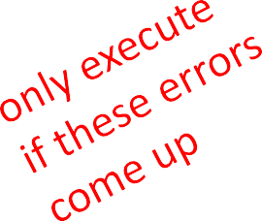
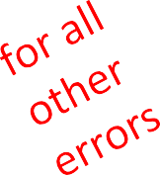
HANDLING SPECIFIC EXCEPTIONS
Separate except clauses to deal with a particular type of exception
try:
a = int(input("Tell me one number: "))
b = int(input("Tell me another number: "))
print("a/b = ", a/b)
print("a+b = ", a+b)
except ValueError:
print("Could not convert to a number.")
except ZeroDivisionError:
print("Can't divide by zero")
except:
print("Something went very wrong.")

Slide 44
OTHER EXCEPTIONS
else: (Python specific feature)
body of this is executed when execution of associated
try body completes with no exceptions
finally:
body of this is always executed after try, else and except clauses, even if they raised another error or executed a break, continue or return
useful for clean-up code that should be run no matter what else happened (e.g. close a file)

Slide 45
WHAT TO DO WITH EXCEPTIONS?
What to do when encounter an error?
fail silently:
substitute default values or just continue
bad idea! user gets no warning
return an “error” value
what value to choose?
complicates code having to check for a special value
stop execution, signal error condition
in Python: raise an exception (throw exception)
raise Exception("descriptive string")

Slide 46

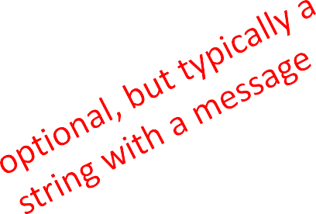
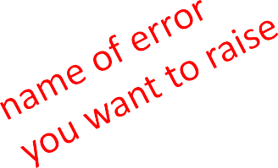
EXCEPTIONS AS CONTROL FLOW
Don’t return special values when an error occurred and then check whether ‘error value’ was returned
Instead, raise an exception when unable to produce a result consistent with function’s specification
C++, Java: throw
raise <exceptionName>(<arguments>)
Example: raise ValueError("something is wrong")
Users can define custom exceptions by creating a new class. This exception class has to be derived, either directly or indirectly, from the built-in Exception class

Slide 47
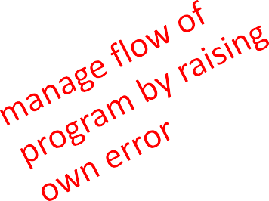
EXAMPLE: RAISING AN EXCEPTION
def get_ratios(L1, L2):
""" Assumes: L1 and L2 are lists of equal length of numbers Returns: a list containing L1[i]/L2[i] """
ratios = []
for index in range(len(L1)): try:
ratios.append(L1[index]/L2[index]) except ZeroDivisionError:
ratios.append(float('nan')) #nan = not a number except:
raise ValueError('get_ratios called with bad arg')
return ratios

Slide 48
ASSERTIONS (Bug prevention)
Want to be sure that assumptions on state of computation are as expected before executing the codes following this assertion
Use an assert statement to raise an AssertionError exception if assumptions not met

Slide 49
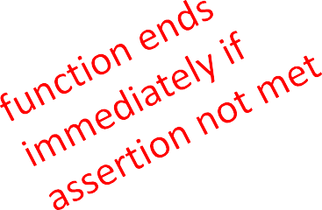
EXAMPLE
def avg(grades):
assert len(grades) != 0, 'no grades data'
return sum(grades)/len(grades)
Raises an AssertionError if it is given an empty list for grades
Otherwise runs ok

Slide 50
ASSERTIONS
Assertions don’t allow a programmer to control response to unexpected conditions
Ensure that execution halts whenever an expected condition is not met
Typically used to check inputs to functions, but can be used anywhere
Can be used to check outputs of a function to avoid propagating bad values
Can make it easier to locate a source of a bug

Slide 51
OBJECT-ORIENTED PROGRAMMING

Slide 52
OBJECT ORIENTED PROGRAMMING (OOP)
EVERYTHING IN PYTHON IS AN OBJECT (and has a type)
Can create new objects of some type
Can use and modify objects
Can destroy objects
Explicitly using del or just “forget” about them
Python system will reclaim destroyed or inaccessible objects – called “garbage collection”

Slide 53
WHAT ARE OBJECTS?
Objects are data abstraction that captures…
an internal representation through data attributes
an interface for interacting with object through methods (aka procedures/functions)
Defines behaviors but hides implementation

Slide 54
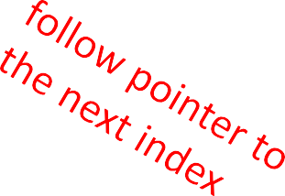
EXAMPLE: List [1,2,3,4]
How are lists represented internally? linked list of cells
L =
1 -> 2 -> 3 -> 4 ->
How to manipulate lists?
L[i], L[i:j]
len(), min(), max(), del(L[i])
L.append(),L.extend(),L.count(),L.index(), L.insert(),L.pop(),L.remove(),L.reverse(), L.sort()
Internal representation should be private
Python does not have built-in support for Arrays.
Correct behavior may be compromised if you manipulate internal representation directly (encapsulation)

Slide 55
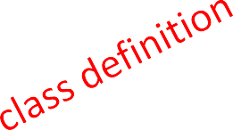


DEFINE YOUR OWN TYPES (CLASS)
Use the class keyword to define a new type
class Coordinate(object):
#define attributes here
Similar to def, indent code to indicate which statements are part of the class definition
The word object means that Coordinate is a Python object and inherits all its attributes (inheritance next lecture)
Coordinate is a subclass of object
object is a superclass of Coordinate

Slide 56
WHAT ARE ATTRIBUTES?
Data and procedures that “belong” to the class
Data attributes
think of data as other objects that make up the class
for example, a coordinate is made up of two numbers
Methods
think of methods as functions that only work with this class
for example, define a distance between two coordinate objects but there is no meaning to a distance between two list objects

Slide 57
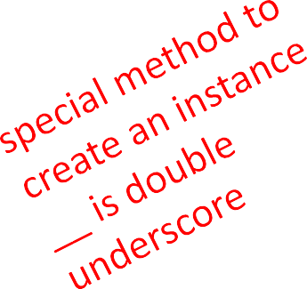

CREATING AN INSTANCE OF A CLASS
First, define how to create an instance of object
Use a special method called __init__() (a Dunder method) to initialize the data attributes (constructor)
class Coordinate(object):
Def init (self, x, y): self.x = x
self.y = y
Dunder methods: special methods - a set of predefined methods used to enrich the classes. Starts and ends with double underscores
https://dbader.org/blog/python-dunder-methods

Slide 58
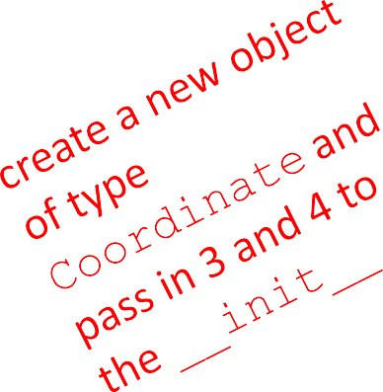
CREATING AN INSTANCE OF A CLASS
c = Coordinate(3,4)
origin = Coordinate(0,0)
print(c.x)
print(origin.x)
Unlike C++, no new operator is used because everything is object
Data attributes of an instance are called instance variables
Don’t provide argument for self, Python does this automatically

Slide 59
WHAT IS A METHOD?
Procedural attribute, like a function that works only with this class
Python always passes the object as the first argument
convention is to use self as the name of the first argument of all methods
The “.” operator is used to access any attribute
a data attribute of an object
a method of an object

Slide 60
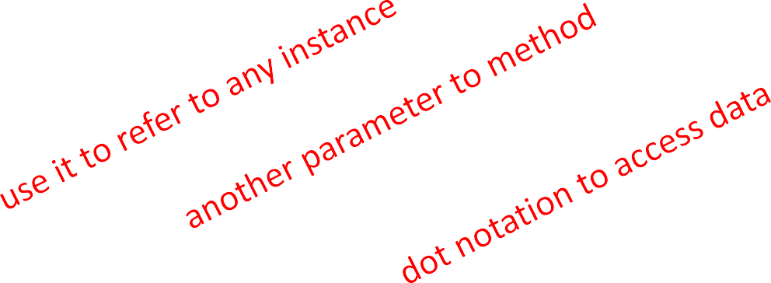
Methods of class Coordinate
class Coordinate(object):
def init (self, x, y):
self.x = x self.y = y
def distance(self, other):
x_diff_sq = (self.x-other.x)**2
y_diff_sq = (self.y-other.y)**2
return (x_diff_sq + y_diff_sq)**0.5
Other than self and dot notation, methods behave just like functions (take params, do operations, return)
Like Java, all the attributes and methods are defined in the same class definition

Slide 61
PRINT REPRESENTATION OF AN OBJECT
>>> c = Coordinate(3,4)
>>> print(c)
< main .Coordinate object at 0x7fa918510488>
Uninformative print representation by default
Define a __str__() method (just like Java toString() method) or “<<“ operator overloading in C++
Python calls the __str__() method when used with print of a class object
you choose what it does! Say that when we print a Coordinate object, want to show:
>>> print(c)
<3,4>

Slide 62
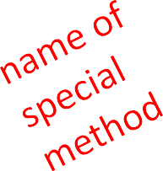
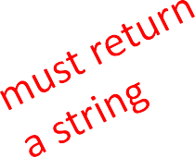
DEFINING YOUR OWN PRINT METHOD
class Coordinate(object):
def init (self, x, y): self.x = x
self.y = y
def distance(self, other): x_diff_sq = (self.x-other.x)**2 y_diff_sq = (self.y-other.y)**2
return (x_diff_sq + y_diff_sq)**0.5
def
str__ |  | (self):
return | "<"+str(self.x)+","+str(self.y)+">"

Slide 63
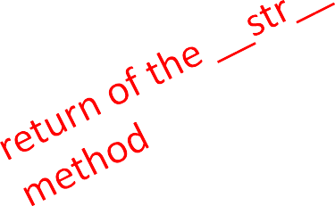
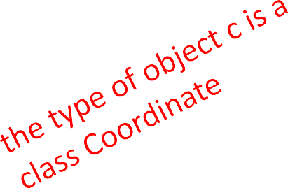
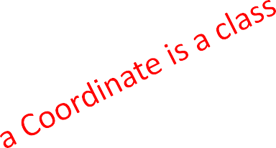
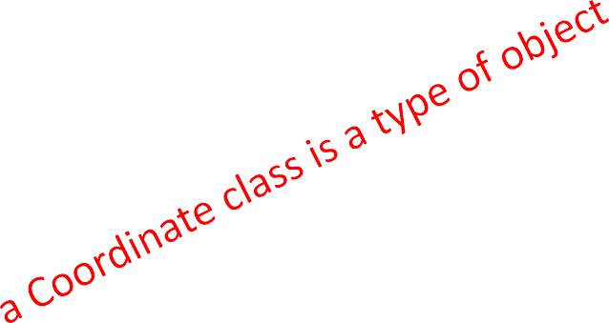
TYPES AND CLASSES
Can ask for the type of an object instance
>>> c = Coordinate(3,4)
>>> print(c)
<3,4>
>>> print(type(c))
<class main .Coordinate>
this makes sense since
>>> print(Coordinate)
<class main .Coordinate>
>>> print(type(Coordinate))
<type 'type’>
use isinstance() to check if an object is a Coordinate
>>> print(isinstance(c, Coordinate)) True

Slide 64
SPECIAL OPERATORS (Operator Overloading)
+, -, ==, <, >, len(), print, and many others
https://docs.python.org/3/reference/datamodel.html#basic-customization
Like print(), can override these to work with your class
Define them with dunder before/after: Operator overloading
add (self, other) | → | self | + other
sub (self, other) | → | self | - other
eq (self, other) | → | self | == other
lt (self, other) | → | self | < other
len (self) | → | len(self)
str (self) ... and others | → | print self

Slide 65


GETTER AND SETTER METHODS
class Animal(object):
def init (self, age): self.age = age self.name = None
def get_age(self):
return self.age def get_name(self):
return self.name
def set_age(self, newage):
self.age = newage
def set_name(self, newname=""):
self.name = newname
def str (self):
return "animal:“ + str(self.name) + ":“ + str(self.age)
getters and setters should be used outside of class to access data attributes
Can use @property decorator to access the instance variable without using getters and setter.

Slide 66
INFORMATION HIDING
Author of class definition may change data attribute variable names
If you are accessing data attributes outside the class and class definition changes, may get errors
Outside of class, recommend to use getters and setters instead use a.get_age(), NOT a.age
good style
easy to maintain
prevents bugs

Slide 67
PYTHON NOT GREAT AT INFORMATION HIDING
Allows you to access data from outside class definition
print(a.age)
Allows you to write to data from outside class definition
a.age = 'infinite'
Allows you to create data attributes for an instance from outside class definition
a.size = "tiny"
It’s not good style to do any of these!
Python Decorators to rescue (sort of!!)

Slide 68

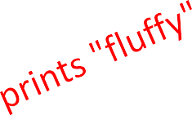
DEFAULT ARGUMENTS
Default arguments for formal parameters are used if no actual argument is given
def set_name(self, newname=""):
self.name = newname
Default argument used here
a = Animal(3)
a.set_name()
print(a.get_name())
Argument passed in is used here
a = Animal(3) a.set_name("fluffy")
print(a.get_name())

Slide 69
CLASS HIERARCHIES
Parent class (superclass)
Child class (subclass)
Inherits all data and behaviors of parent class
Add more info
Add more behavior
Override behavior
Animal
Person
Cat
Rabbit
Student

Slide 70
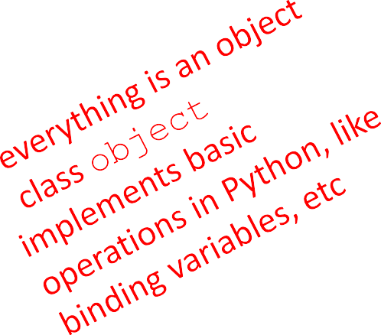
INHERITANCE: PARENT CLASS
class Animal(object):
def init (self, age):
self.age = age
self.name = None
def get_age(self):
return self.age
def get_name(self):
return self.name
def set_age(self, newage):
self.age = newage
def set_name(self, newname=""): self.name = newname
def str (self):
return "animal:"+str(self.name)+":"+str(self.age)

Slide 71
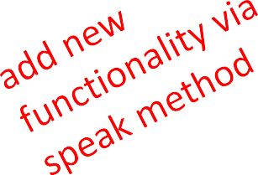
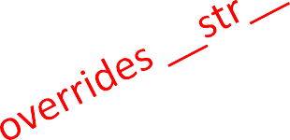
INHERITANCE: SUBCLASS
class Cat(Animal):
def speak(self):
print("meow")
def str (self):
return "cat:"+str(self.name)+":"+str(self.age)
Add new functionality with speak()
instance of type Cat can be called with new methods
instance of type Animal throws error if called with Cat’s new method
__init__ is not missing, uses the Animal version

Slide 72
WHICH METHOD TO USE? (Polymorphism, overriding)
Subclass can have methods with same name as superclass
For an instance of a class, look for a method name in current class definition
If not found, look for method name up the hierarchy (in parent, then grandparent, and so on)
Use first method up the hierarchy that you found with that method name
Like Java, by default they are all virtual functions

Slide 73
Overloading vs Overriding
Basically, Python keeps only the latest definition of a method you defined.
That means that Python doesn’t support function overloading.
Try this out :
def sum (x, y):
return x + y
def sum (x, y, z):
return x + y + z
sum(5, 10)
Traceback (most recent call last): File “<pyshell#8>”, line 1, in <module> sum(2,3) TypeError: add() missing 1 required positional argument: ‘c’

Slide 74
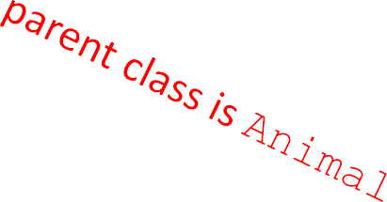








class Person(Animal):
def init (self, name, age):
 | Animal. init (self, age)
 | self.set_name(name)
 | self.friends = []
def get_friends(self):
return self.friends
def add_friend(self, fname):
if fname not in self.friends: self.friends.append(fname)
def speak(self):
print("hello")
def age_diff(self, other):
diff = self.age - other.age print(abs(diff), "year difference")
def str (self):
return "person:"+str(self.name)+":"+str(self.age)

Slide 75



import random
class Student(Person):
def init (self, name, age, major=None): Person. init (self, name, age) self.major = major
def change_major(self, major):
self.major = major def speak(self):
r = random.random() if r < 0.25:
print("i have homework")
elif 0.25 <= r < 0.5:
print("i need sleep") elif 0.5 <= r < 0.75:
print("i should eat") else:
print("i am watching tv") def str (self):
return "student:"+str(self.name)+":"+str(self.age)+":"+str(self.major)

Slide 76


CLASS VARIABLES
Class variables and their values are shared between all instances of a class. Defined outside of all the methods, class variables are, by convention, typically placed right below the class header and before the constructor method and other methods.
class Rabbit(Animal):
tag = 1
def init (self, age, parent1=None, parent2=None): Animal. init (self, age)
self.parent1 = parent1 self.parent2 = parent2
self.rid | = | Rabbit.tag
Rabbit.tag += 1
tag used to give unique id to each new rabbit instance
Variable scopes in Python classes:
https://stackoverflow.com/questions/5690888/variable-scopes-in-python-classes

Slide 77
Module, Packaging

Slide 78

Module
Module allows to logically organize Python definitions and statements in a file. The file name is module name with the suffix .py appended.
Functions
Classes
Variables
Importing definitions in a module
>>> import myModule
myModule.func()
>>> from myModule import func
func()
>>> from myModule import *
func()
>>> import myModule as mod
mod.func()
>>> from myModule import func as myFunc
myFunc()

Slide 79

Packages
Packages allows for a hierarchical structuring of the module namespace using dot notation. In the same way that modules help avoid collisions between global variable names, packages help avoid collisions between module names
It makes use of the operating system’s inherent hierarchical file structure.

Slide 80
Standard Modules/Packages
Standard Library Modules:
https://docs.python.org/3/library/
https://docs.python.org/3/py-modindex.html (in alphabetical order)
Python Built-in Functions
Popular modules and packages:
https://wiki.python.org/moin/UsefulModules
https://pythontips.com/2013/07/30/20-python-libraries-you-cant-live-without/ (Top 20 libraries)
import <module_name>; dir(module_name) lists the names of all the functions in the module
Second language is always good
But different communication mechanisms

Slide 81
To learn for future assignments
Decorators ++ : https://realpython.com/primer-on-python-decorators/
First class objects, function as parameters with arguments
Args: kwargs: https://realpython.com/courses/python-kwargs-and-args/
Inner functions
Meaning of Decorators and Decorator Patterns
At least up to “ A Few Real World Examples” ( you will know why it’s a bonus. ^^)
Lambda expression/function(from Lambda Calculus, Anonymous function)
https://realpython.com/python-lambda/
Map, Filter, Reduce functions : paradigms of functional programming
https://www.learnpython.org/en/Map,_Filter,_Reduce
f-Strings Formatting: https://realpython.com/python-string-formatting/

